Slide 1


Ship Operating Conditions and Mission Profiles Examples Revision of 9 March 2026
Dr. Norbert Doerry
http://doerry.org/norbert/MarineElectricalPowerSystems/index.htm
© 2026 by Norbert Doerry This work is licensed via: CC BY 4.0 (https://creativecommons.org/)

Slide 2
Essential Questions
What are ship operational (operating) conditions and what are they used for? | Understand
What are operational modes and ship states and what are they used for? | Understand
What is a ship state participation table and what is it used for? | Understand
What is a ship deployment and employment profile and what is it used for? | Understand

Slide 3
Introduction
A representation of the physical ship is often insufficient to predict performance of the ship. Other possible factors include:
The environment the ship operates in (not the subject of this presentation)
Different ways the ship is intended to be used
Operational (or operating) conditions.
The percentage of time that the ship is in each operational condition
Mission profiles
Each type of analysis may have different sets of operational conditions and mission profiles.

Slide 4
EPLA
Determine required power (current) rating of power system equipment.
Generator sets, switchboard bus bars, bus ties, transformers, power electronic converters, shore power connection.
Also used to determine 24-hour averages for fuel consumption calculations.
DPC 310-1 or IEEE Std 45.1
Uses operating conditions
Does not use Mission Profiles

Slide 5
Endurance Fuel Calculations
Determine the required size of fuel tanks.
DPC 200-1
Operating conditions
24-hour average loads
Mission Profile
Operational presence speed time profile

Slide 6
Annual (lifetime) fuel calculations
Estimate the amount of fuel consumed each year over the lifetime of the ship.
Used as part of calculating Total Ownership Cost estimates.
DPC 200-2
Operating conditions
Ship States correspond to operating conditions
Mission Profiles
Each ship state may have a speed-time profile.
Operational modes expressed as a fraction of time in each ship state
Ship state participation table
Ship deployment and employment profile indicates fraction of time in each operational mode for each year of the ship’s service life
May have multiple deployment and employment profiles

Slide 7
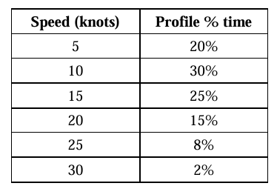
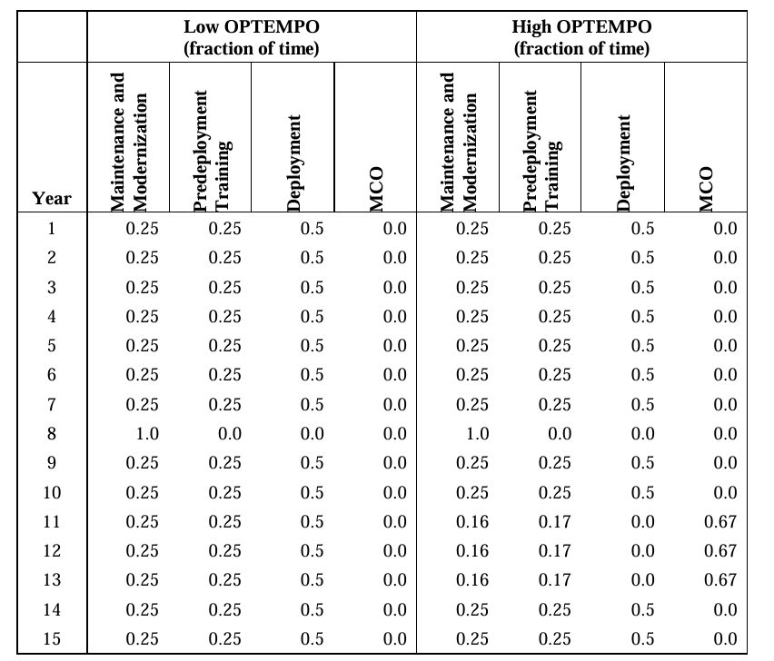
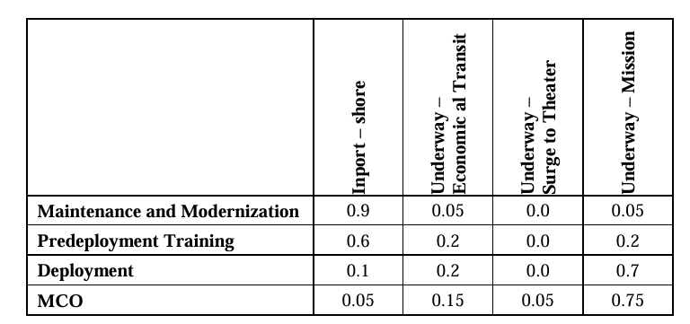
Example: Annual Fuel Calculations
Underway – Mission
Speed – Time Profile
Ship deployment and employment profile
Operational
Modes
Ship States (Operating Conditions)
Ship state participation table
Operational Modes
MCO = Major Combat Operations
Source: DPC 200-2

Slide 8
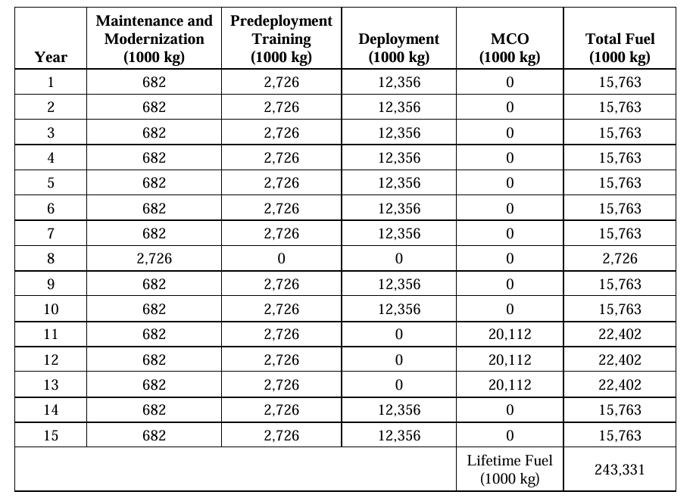
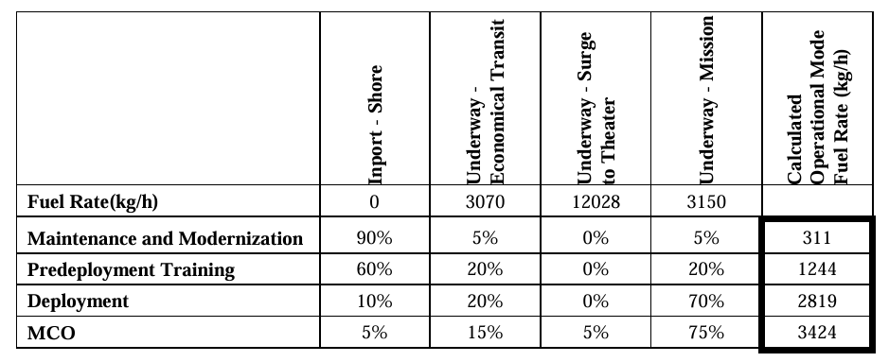
Example: Annual Fuel Calculations (continued)
High OPTEMPO Annual (Lifetime) Fuel Consumption
Operational Mode fuel rate

